Slide 1
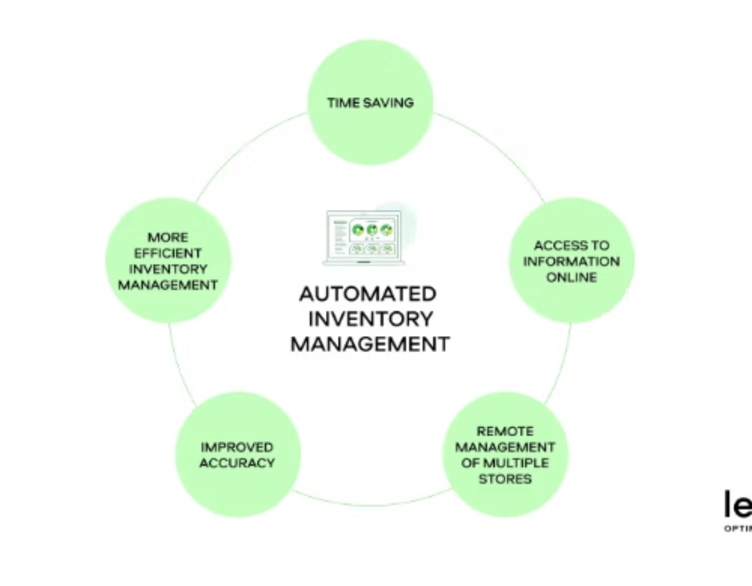
SmartStock Frontend: AI-Powered Inventory Forecasting
An intelligent web application designed to transform retail inventory management through predictive analytics and intuitive design. Five interactive dashboards work together to optimize stock levels, reduce waste, and improve decision-making across your retail operations.
-Presented By: Smriti

Slide 2
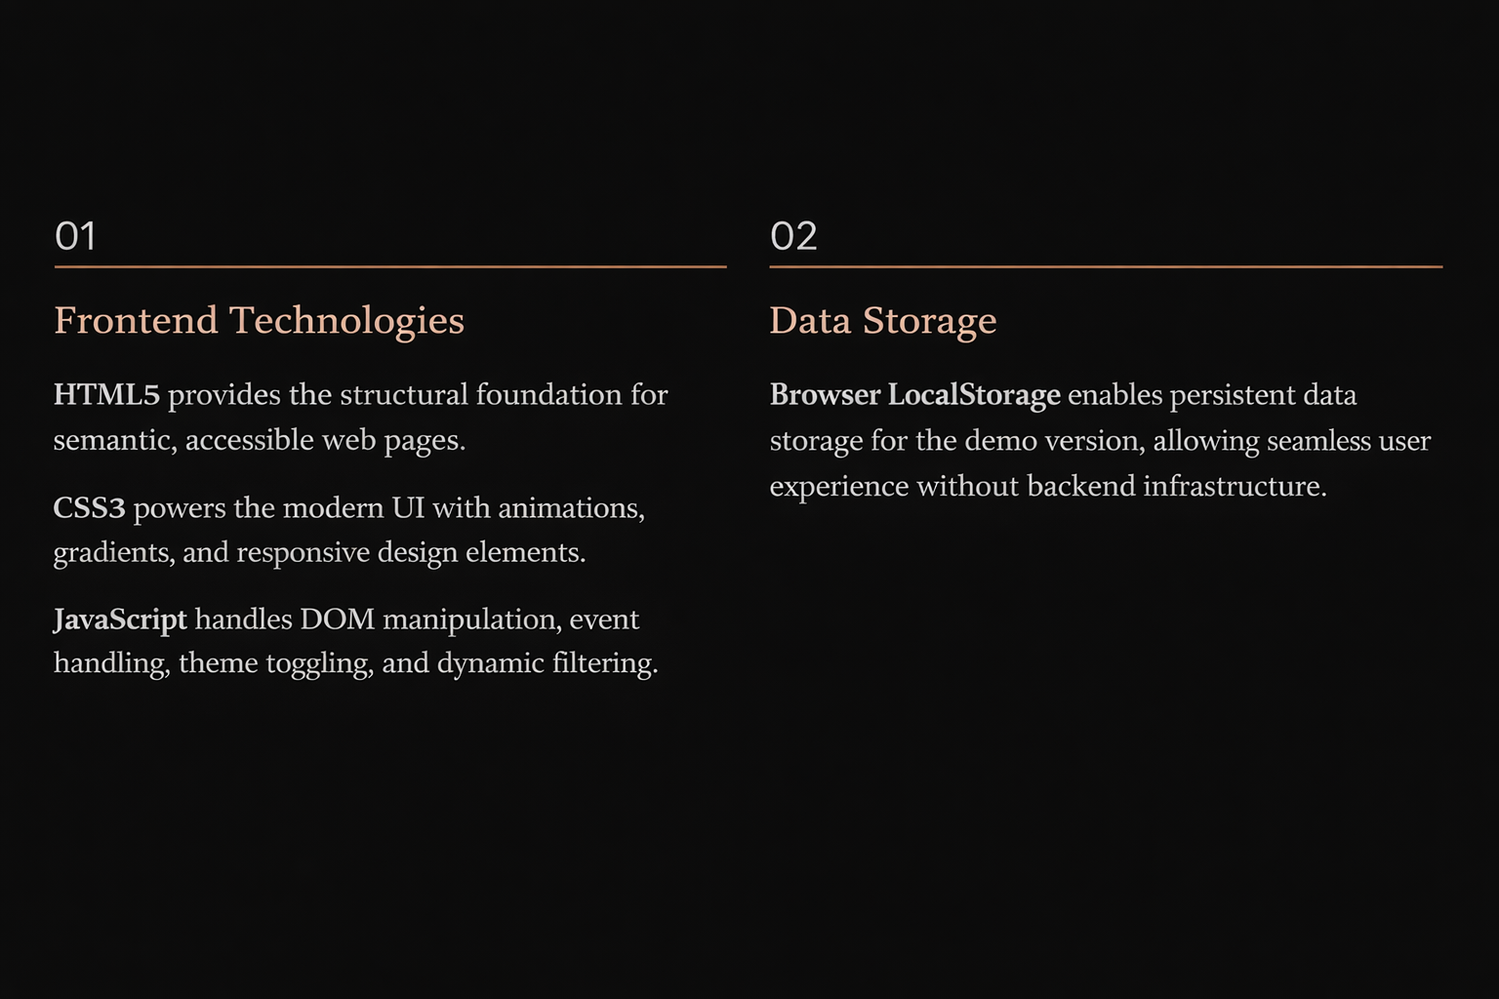
Technology Stack:

Slide 3

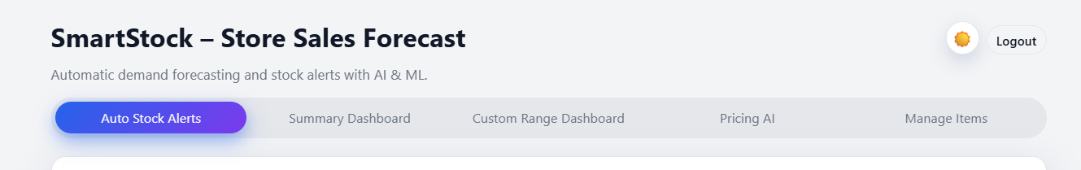
MILESTONE 1
Core Features:
Design Philosophy
Core Principles
We adopted a card-based modern layout approach that prioritizes clarity and ease of use. Every element serves a purpose—from the persistent navigation bar to the carefully selected color palette that enhances readability and reduces cognitive load.
Consistent header across all dashboards
Unified color theme for visual coherence
Responsive design adapting to any screen
Minimal interface maximizing data visibility

Slide 4

Navigation Architecture
01
02
03
Auto Stock Alerts
Summary Dashboard
Custom Range Dashboard
Real-time monitoring of inventory levels with intelligent notifications
High-level insights and key metrics at a glance
Time series analysis for trend identification
04
05
Pricing AI
Manage Items
Dynamic pricing recommendations based on stock levels
Complete inventory control and data management
Active tab highlighting ensures users always know their current location, while the persistent header provides quick access to logout functionality.

Slide 5
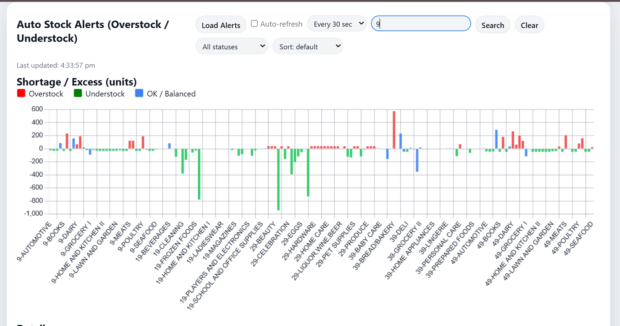

MILESTONE 2
Auto Stock Alerts: Your Operational Command Center
The heart of SmartStock—this dashboard provides real-time visibility into stock status across all locations. Intelligent algorithms continuously analyze inventory levels against predicted demand, automatically flagging overstock and understock situations before they impact your business.
24/7
Monitoring
100%
Visibility

Slide 6


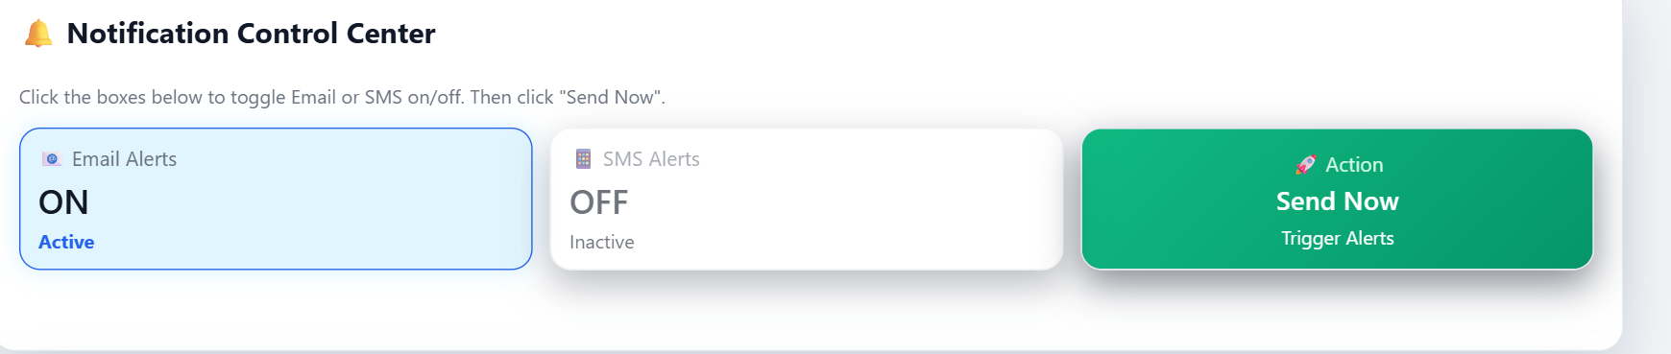

Alert Controls & Stock Visualization
Email Notifications
SMS Alerts
Toggle email alerts on/off with a single click. Send immediate notifications to stakeholders when critical stock situations arise.
Enable SMS notifications for time-sensitive inventory issues. Perfect for reaching team members on the go.
Auto-Refresh
Live updates ensure your data is always current. Optional auto-refresh keeps dashboards synchronized without manual intervention.
Advanced filtering capabilities allow you to search by item family, filter by status (overstock/understock), and visualize shortage and excess stock through intuitive bar graphs. Color-coded visualizations make patterns immediately apparent.

Slide 7
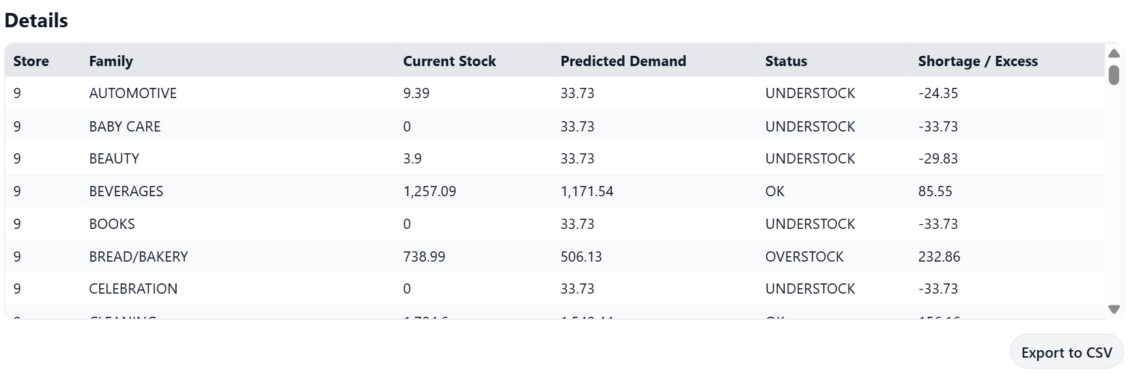
Comprehensive Stock Details Table
Data at Your Fingertips
The scrollable table accommodates large datasets while maintaining readability.
Key Columns
Store Number & Location
Item Family Classification
Current Stock Levels
AI-Predicted Demand
Status Indicators
Shortage/Excess Quantities

Slide 8

MILESTONE 3
Summary Dashboard
Understock Items
Overstock Items
Real-time count of items below optimal levels, calculated from auto stock alerts
Immediate visibility into excess inventory tying up capital
Stockout Items
Stores Impacted
Critical alerts for items completely out of stock
Geographic scope of inventory challenges
High-level insights enable management to make informed decisions quickly. Each metric card provides at-a-glance understanding of inventory health, while the critical items table highlights the most urgent situations requiring attention.

Slide 9
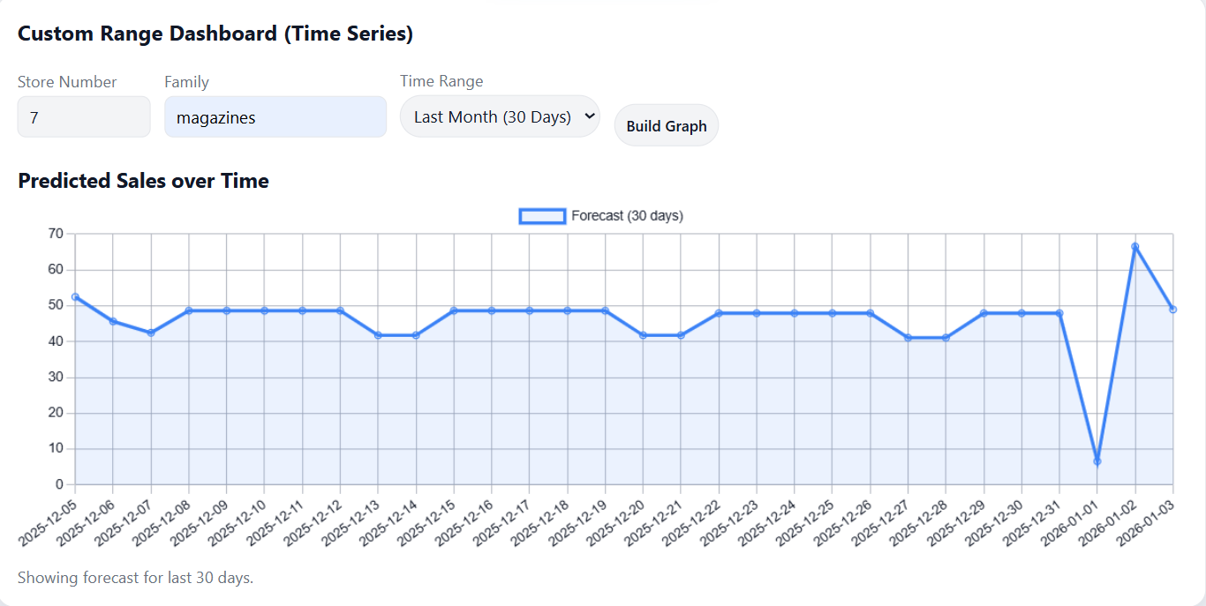

Custom Range Dashboard: Trend Analysis
Time Series Intelligence
Analyze sales patterns across any time period to identify trends, seasonality, and demand fluctuations. This powerful tool supports strategic planning and helps optimize future inventory decisions.
User Controls :
Store number selection
Item family filtering
Flexible date range picker
Interactive line graph visualization
The clean, readable chart interface makes complex data accessible to all stakeholders, regardless of technical expertise.

Slide 10
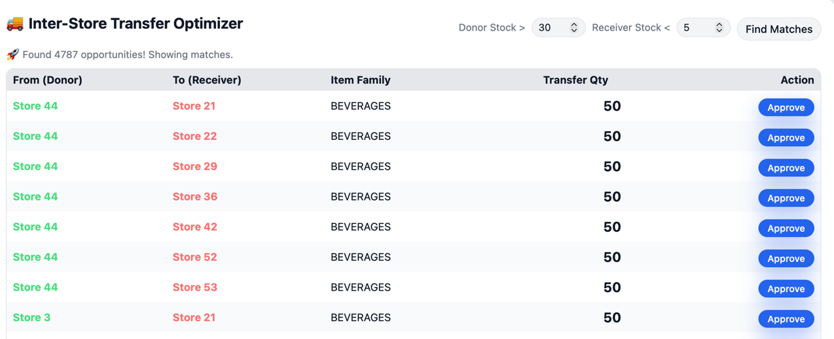





MILESTONE 4
Pricing AI: Dynamic Strategy Recommendations
Current Stock Analysis
System evaluates existing inventory levels across all locations
Demand Prediction
AI algorithms forecast future demand based on historical patterns
Price Optimization
Automated recommendations with clear business reasoning
The Pricing AI dashboard transforms complex inventory data into actionable pricing strategies. Each recommendation includes the reasoning behind the suggestion, helping teams understand and confidently execute pricing decisions that maximize profitability while optimizing stock levels.

Slide 11
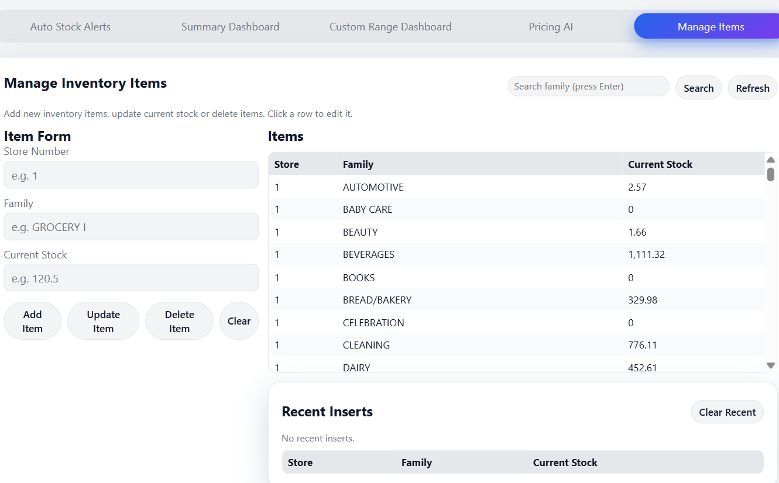
Manage Inventory: Complete Control
Administrative Features
Add New Items
Simple form-based interface for expanding inventory catalog
Update Stock Values
Remove discontinued products with confirmation safeguards
Delete Items
Quick modifications to existing inventory levels
Track Changes
Recent inserts section maintains audit trail
Frontend Development: Mission Accomplished
SmartStock delivers a fully functional, multi-dashboard frontend that combines responsive design with powerful functionality. Integrated charts, tables, and filters work seamlessly with backend APIs to support AI-based inventory decision making across your entire retail operation.

Slide 12
THANKYOU!

